Slide 2
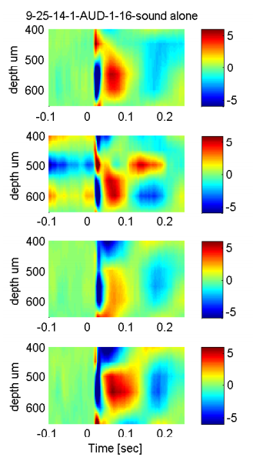
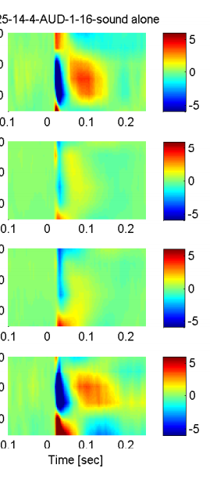
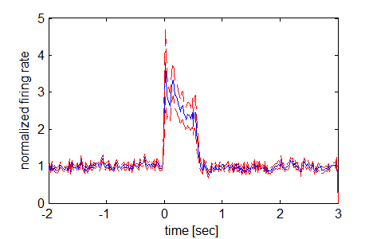
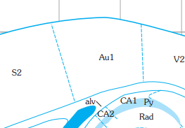
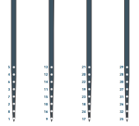
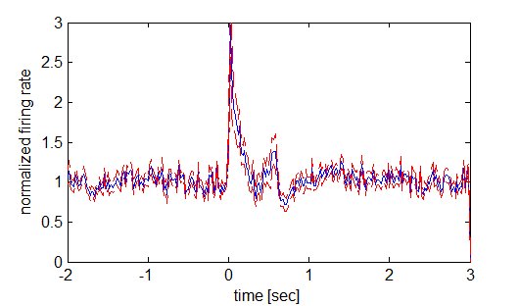
CSD and Spectral/pop_CSD_sound_only (snipped from pdf)
Figure 2: Scopolamine reduces noise-evoked intra-cortical current sources in auditory cortex. (left) Illustration of recording electrode/infusion pipette configuration and position within auditory cortex.

Slide 3
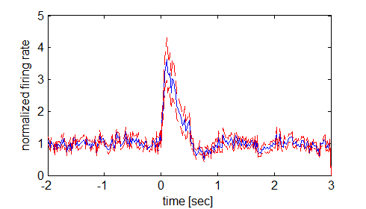
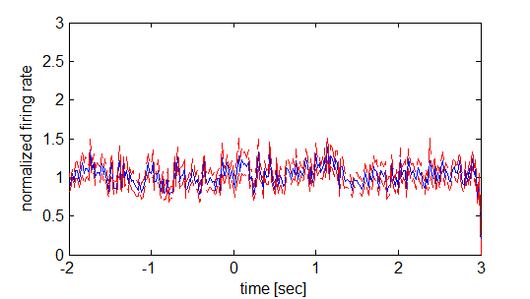
Figure 3: Scopolamine effects on PFC. Population spiking (A), LFP ERP (B).
Demonstrate reduced amplitude ERPs with scopolamine (add spikes after noise rejection)

Slide 4
For PFC ERP before and after mec, p=0.6968. paired ttest all mice
Figure 4. Mecamylamine effects on Auditory and PFC (Other data go into supplemental). Population spiking (A), LFP ERP (B).

Slide 5
Figure 5. Scop alters different freq components in Aud. Population LFP spectrum within auditory cortex during 500 ms sound presentation with and without scop.

Slide 6
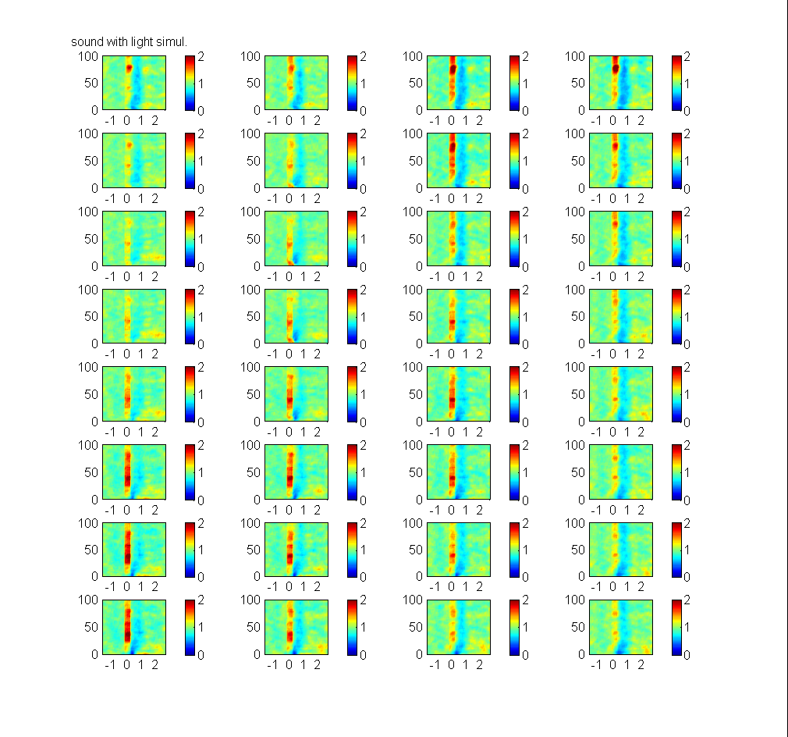
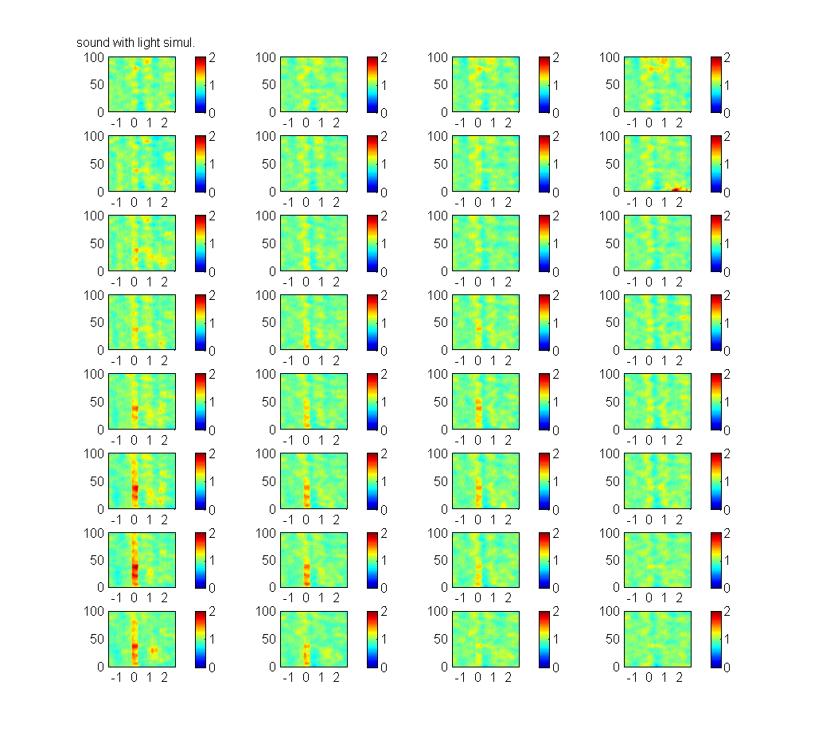
9-16-14 Before 100 ug/ugl scop.→ After infusion

Slide 7
Figure 6. Scop alters different freq components in PFC. Population LFP spectrum within PFC during 500 ms sound presentation with and without scop.

Slide 8
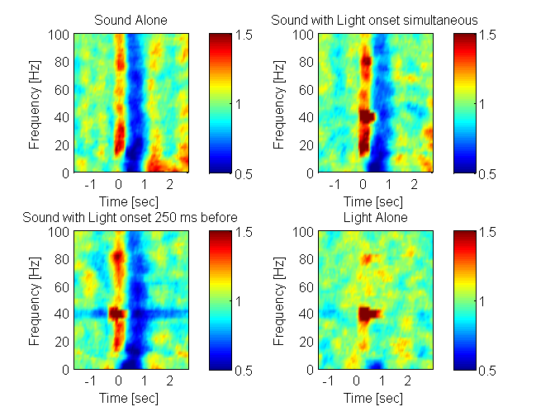
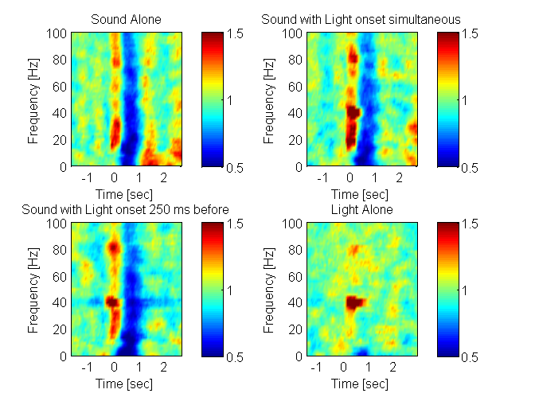
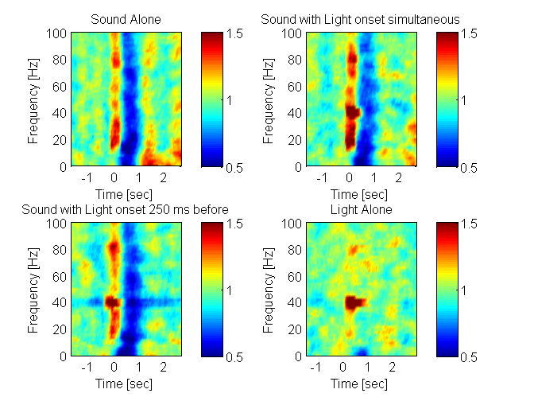
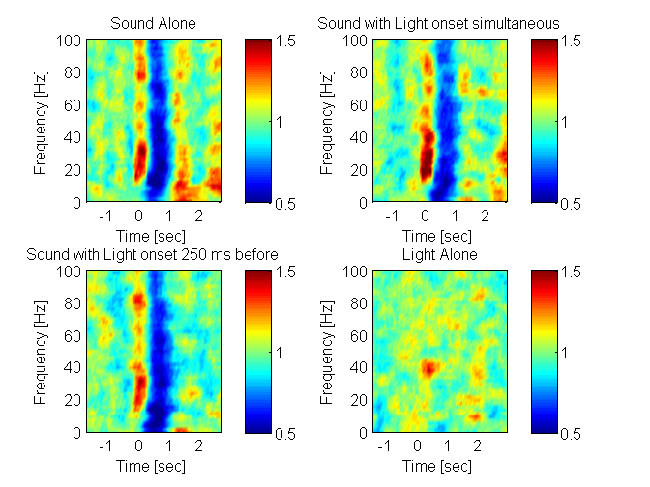
9-16-14, 4 condition pre-infusion
1
2
3
4

Slide 9
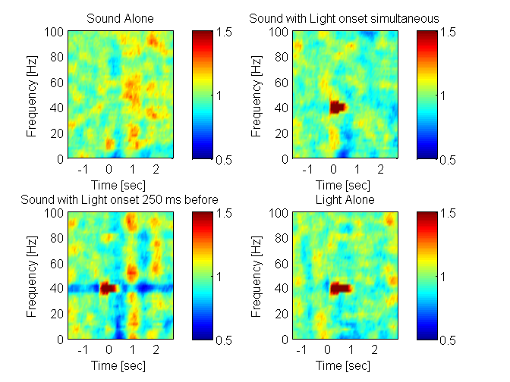
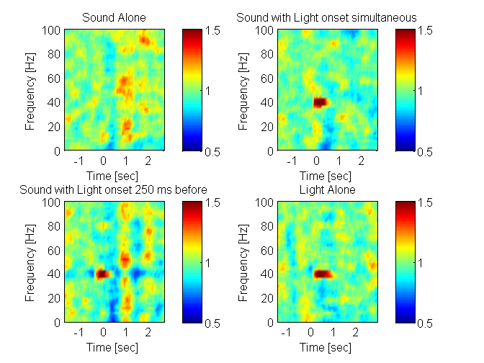
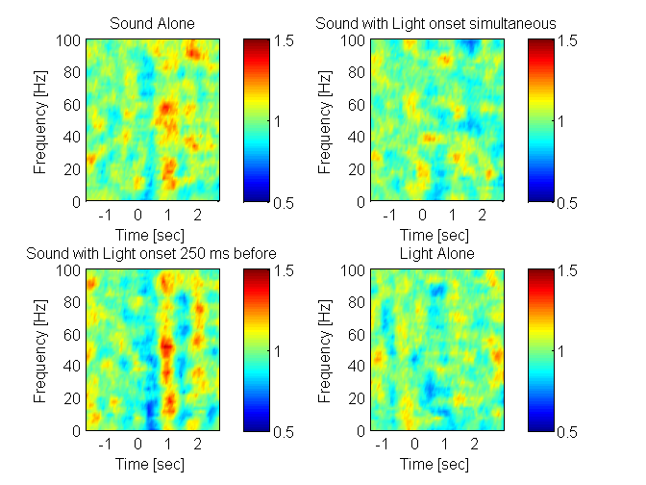

9-16-14, 4 condition post-infusion (scopolomine 100 ug/uL)
1
2
3
4

Slide 10
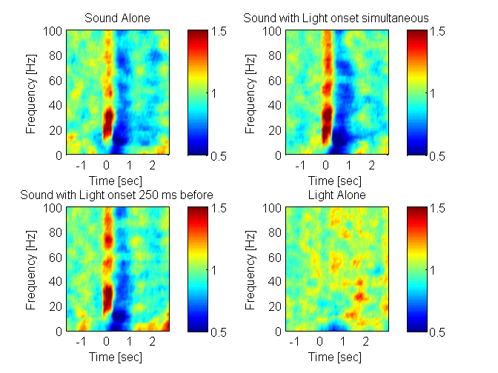
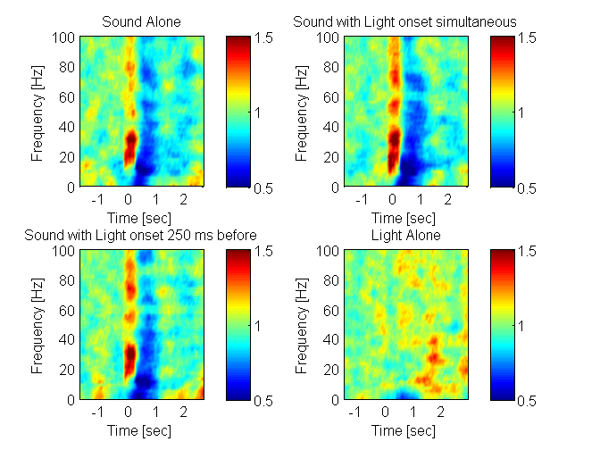
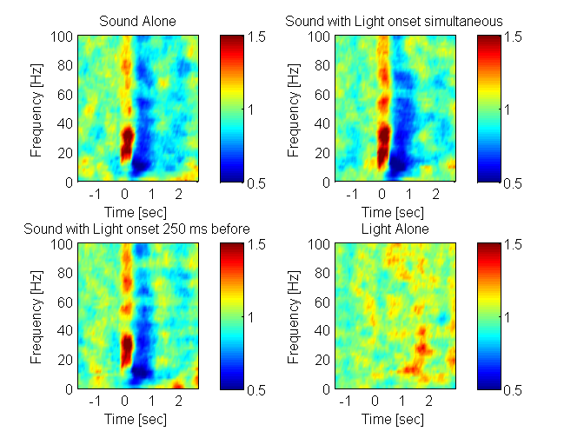

9-21-14, 4 condition pre infusion
1
2
3
4

Slide 11
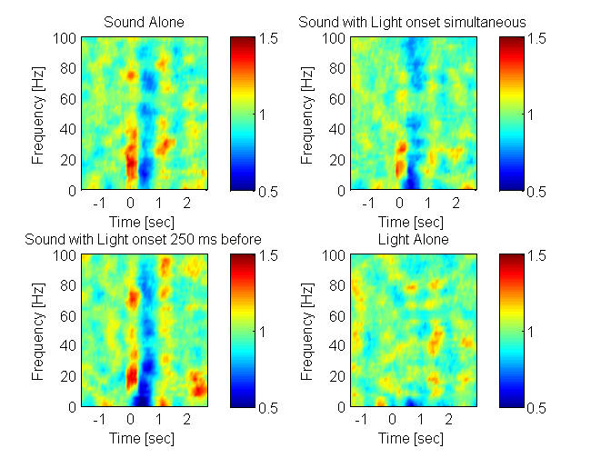
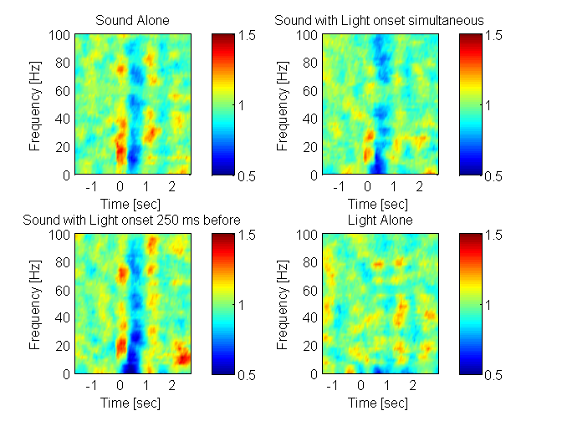
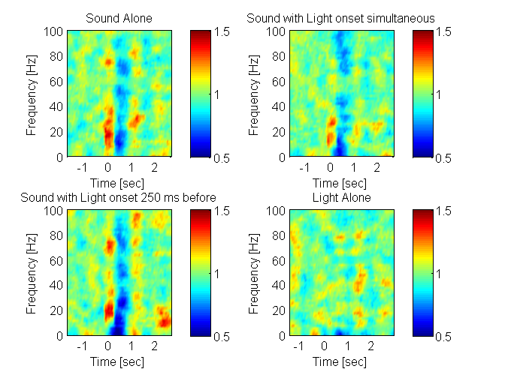
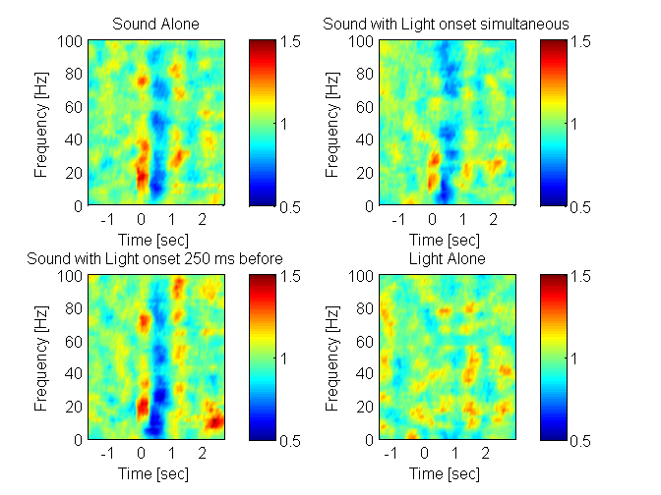
9-21-14, 4 condition post infusion (scopolomine)
1
2
3
4

Slide 12
Figure 7. Connections between PFC and aud, which is altered by Scop. Show LFP-LFP coherograms between aud and PFC with and without scop. Plot a few channels.

Slide 13
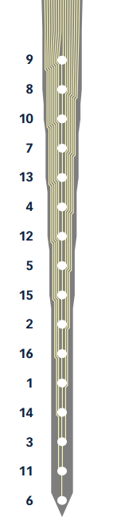
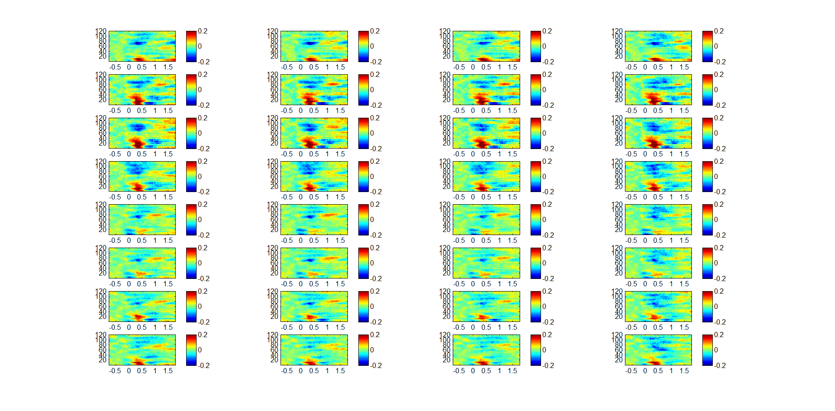
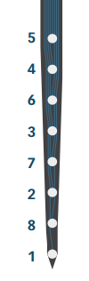
8-26-14 aud channel 1-16, pfc channels 1-16, sound alone

Slide 14
Figure 8. Presynaptic Aud input influence information processing in PFC. Spike in PFC phase locked to field in LFP, coherence on interesting LFP channels in Aud, and PFC.

